Slide 1
Start Right
Sources: TED Talks | Specific sources in Notes Section
Notes:
3 short TED talks which gives some good inputs on achieving success the right way, speaking right so that people will listen and guiding right so that people will work motivated.

Slide 2
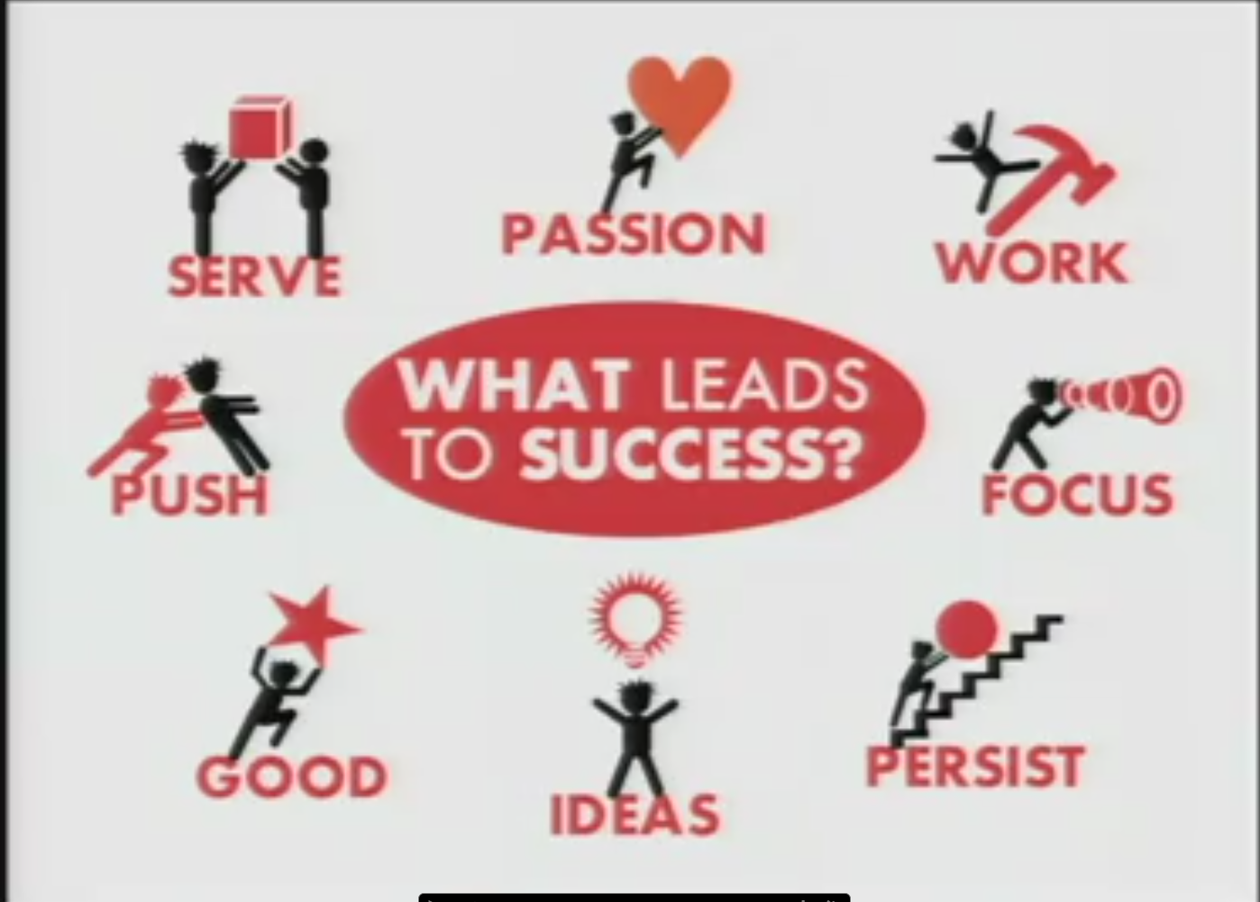
Notes:
If you want to be successful in whatever you want to then ensure that you check the above 8 points.
http://www.ted.com/talks/richard_st_john_s_8_secrets_of_success#t-188357

Slide 3
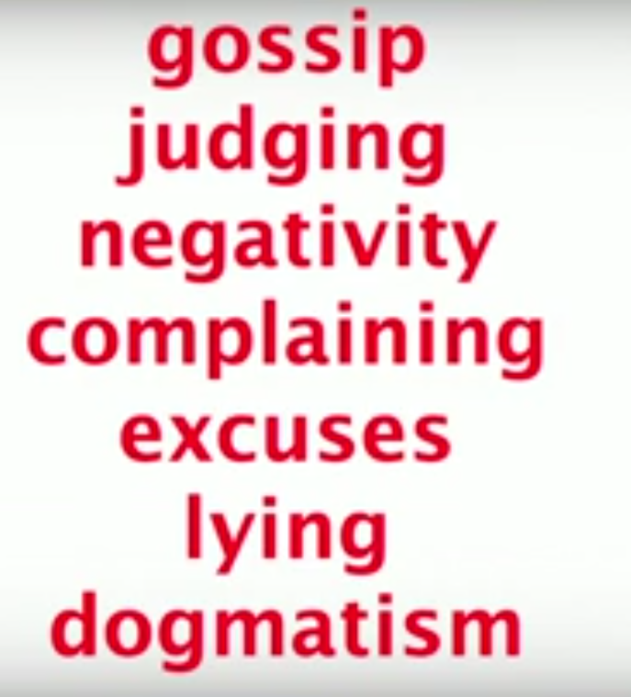


Speak to be Listened
Notes:
http://www.ted.com/talks/julian_treasure_how_to_speak_so_that_people_want_to_listen#t-405443
Don’t indulge in the text on red and be the ones on the right and use the tool kit right. May be get a voice coach ☺

Slide 4
Motivating the people for Out of box thinking and tasks of 21st century!
Intrinsic motivation
Autonomy
Mastery
Purpose
Notes:
http://www.ted.com/talks/dan_pink_on_motivation
Let people achieve these 4 points and it will motivate them to achieve the tasks and reduce attrition because often it is not money that people want.

